Slide 1


Provider Training:
Disability Determination for CASSIP/HSCSN Enrollment
with DHCF/Comagine
May 9, 2023

Slide 2
  AGENDA
Purpose and Policy
CASSIP Enrollment Overview
  Eligibility Criteria
  Disability Definition for CASSIP Enrollment
CASSIP Referral Process
  Updated CASSIP Referral Form
  Operational Procedures & Timeframes
  Comagine Portal
Questions & Answers

Slide 3
  Purpose and Policy
Purpose
To define the disability determination criteria for District of Columbia (DC) Medicaid beneficiaries aged 0 - 20 years, seeking enrollment into the Child and Adolescent Supplemental Security Income Program (CASSIP) based on a qualified disability, as determined by the DC Department of Health Care Finance (DHCF), or its authorized agent.
Policy
All DC Medicaid beneficiaries aged 0 - 20 years are eligible for voluntary enrollment into CASSIP if they either concurrently receive federal Supplemental Security Income (SSI), or is determined by DHCF or its authorized agent, to meet established disability criteria described later in this presentation.

Slide 4
Disability Definition for CASSIP Enrollment
A DC Medicaid beneficiary under the age of 21 years, seeking enrollment into CASSIP based on disability, is considered disabled if there’s a “medically determinable physical or mental impairment or combination of impairments (MDI) that causes marked and severe functional limitations, and that can be expected to cause death or that has lasted or can be expected to last for a continuous period of not less than 12 months.”

Slide 5
Eligibility Criteria
To be eligible for voluntary enrollment into CASSIP, an individual must meet the following criteria:
Active enrollment in the DC Medicaid program at the time of the CASSIP enrollment request; and
Under the age of 21 years old; and
Actively receiving SSI; or
Determined by DHCF or its authorized agent to meet the disability definition and criteria utilized by the Social Security Administration (SSA).

Slide 6
Sequential Evaluation of Disability
DHCF has adopted the sequential disability evaluation process set forth in the applicable SSA regulations, which requires –
The Provider Referral form clearly states a diagnosis(es) that either meets, medically equals, or functionally equals at least one of the impairments contained in the SSA Listing of Impairments (Listing); and
The impairment results in severe functional limitations; and
Such impairment can be expected to cause death, or that has lasted or can be
expected to last for a continuous period of not less than 12 months.

Slide 7
Medically Determinable Impairment (MDI)
There are three (3) ways to establish MDI:
Meets a Listing – the indicated diagnosis(es) explicitly meets an impairment contained in the Listing, and there is information in the case record that said diagnosis must also meet the requirements described in the Listing that correspond to the applicable impairment.
2. Medically Equals a Listing – the impairment is medically equivalent to a listing
if it is at least equal in severity and duration to the criteria of any listed
impairment;
3. Functionally Equals a Listing - whether the child's impairment is of listing-level
severity, which means it must result in “marked” limitations in two (2) “functional
domains” or “extreme” limitation in one “functional domain.”

Slide 8
Severity of Impairment
A severe impairment is one that is more than “a slight abnormality or a combination of slight abnormalities that causes more than minimal functional limitations.”
In assessing severity, DHCF or its authorized agent considers not only the individual’s MDI, but also such factors as:
Age;
Effects of chronic illness;
Impact of medication(s);
Effects of structured or highly supported settings;
Adaptions;
Time spent in therapy;
School attendance; and
Pain and other symptomatology.

Slide 9
Functional Domains
The SSA regulations identify six (6) discrete functional domains, which broadly refer to activities that the individual can and cannot do at home, at school, and in the community compared to typical individuals the same age who do not have impairments:
Acquiring and using information;
Attending and completing tasks;
Interacting and relating with others;
Moving about and manipulating objects;
Caring for the individual’s self; and
Health and physical well-being.

Slide 10
Marked Limitation
A “marked” limitation in a domain is found when the impairment(s) interferes seriously with the ability to independently initiate, sustain, or complete activities.
The individual day-to-day functioning may be seriously limited when the individual impairment(s) limits only one activity or when the interactive and cumulative effects of the individual impairment(s) limit several activities.
“Marked” limitation also means a limitation that is “more than moderate” but “less than extreme.” It is the equivalent of the functioning we would expect to find on standardized testing with scores that are at least 2, but less than 3, standard deviations below the mean.
  If the individual has not attained age 3, then generally find that the individual has a “marked” limitation if they are functioning at a level that is more than one-half (1/2) but not more than two-thirds (2/3) of their chronological age when there are no standard scores from standardized tests in the individual case record.

Slide 11
Marked Limitation (continued)
  If the individual is over the age of 3, then find that they have a “marked” limitation when they have a valid score that is two standard deviations or more below the mean, but less than three standard deviations, on a comprehensive standardized test designed to measure ability or functioning in that domain, and their day-to-day functioning in domain-related activities is consistent with that score.

Slide 12
Extreme Limitation
An “extreme” limitation exists when the impairment(s) interferes very seriously with the ability to independently initiate, sustain, or complete activities.
The day-to-day functioning may be very seriously limited when the impairment(s) limits only one activity or when the interactive and cumulative effects of the impairment(s) limit several activities.
“Extreme” limitation also means a limitation that is “more than marked.” The rating should be given to the most substantial limitations. However, “extreme limitation” does not necessarily mean a total lack or loss of ability to function.
It is the equivalent of the functioning we would expect to find on standardized testing with scores that are at least three standard deviations below the mean.

Slide 13
Extreme Limitation (continued)
  If the individual has not attained age 3, we will generally find that the individual has an “extreme” limitation if the individual is functioning at a level that is one-half of the individual’s chronological age or less when there are no standard scores from standardized tests in the individual case record.
  B. If the individual is a child of any age (birth to the attainment of age 18), we will find that
  the individual has an “extreme” limitation when the individual has a valid score that is
  three standard deviations or more below the mean on a comprehensive standardized
  test designed to measure ability or functioning in that domain, and the individual day-
  to-day functioning in domain-related activities is consistent with that score.

Slide 14
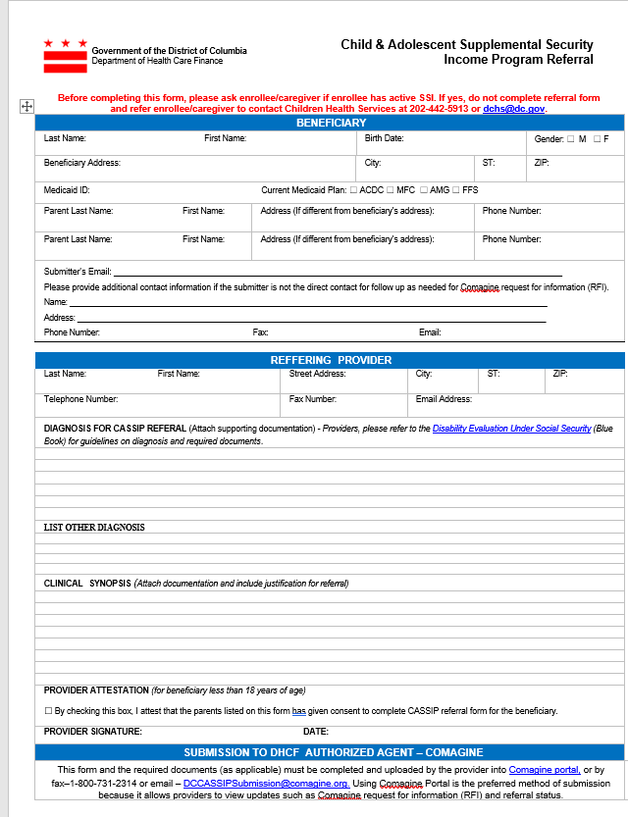
Updated CASSIP Referral Form
The CASSIP referral form
has been updated to include additional information required for CASSIP referral request.

Slide 15
Updated CASSIP Referral Form Instructions
The CASSIP referral form must include the following in order to be received complete:
  Direct Contact Information for the Submitter: This is the designated person who will respond to Comagine Health if a request for additional information is needed.
  Diagnosis for CASSIP referral: Providers must specify the diagnosis under the SSA Blue Book that they want Comagine Health to review.
  Other Diagnosis: Providers should specify any additional diagnosis in this section. If no additional diagnosis, please indicate "None"
  Clinical Synopsis: This is the medical justification section for your request. Supporting documentation to support your synopsis should be attached with the request.
  ***All sections of the CASSIP referral form must be completed***

Slide 16
CASSIP Common Diagnoses
Functional Assessment Required
  112.10 Autism spectrum disorder (see 112.00B8)
  111.07 Cerebral Palsy (see 111.00D1, 111.00D2
  111.13 Muscular dystrophy (see 111.00D1, 111.00D2)
  111.18 Traumatic brain injury (see 111.00D1, 111.00D2)
  112.05 Intellectual disorder (see 112.00B4)
  112.11 Neurodevelopmental disorders (see 112.00B9)
  112.14 Developmental disorders in infants and toddlers (see 112.00B11, 112.00I)
  112.15 Trauma- and stressor-related disorders (see 112.00B11, 112.00I)
*Please note all Mental Health diagnoses require a functional assessment

Slide 17
CASSIP Common Diagnoses
No Functional Assessment Needed (Medical Documentation only):
111.02 Epilepsy/Seizure Disorder
110.06 Down Syndrome
110.08 Catastrophic congenital disorders (ex. Cri du chat syndrome, Tay-Sachs disease, Edward’s syndrome, Patau syndrome, Anencephaly, Cyclopia)
114.00 Immune System Disorders (Lupus, Systemic vasculitis, Scleroderma, HIV, Connective Tissue diseases, etc.)
111.21 Multiple sclerosis (see 111.00D1, 111.00D2), Please note that a comprehensive PT or OT assessment is needed to assess the beneficiary’s motor function.
Please note: This is not a complete list of CASSIP eligible conditions. For a comprehensive list, please follow the link below:
https://www.ssa.gov/disability/professionals/bluebook/ChildhoodListings.htm

Slide 18
How to Log into the Provider Portal and Start a Request
Section 2

Slide 19
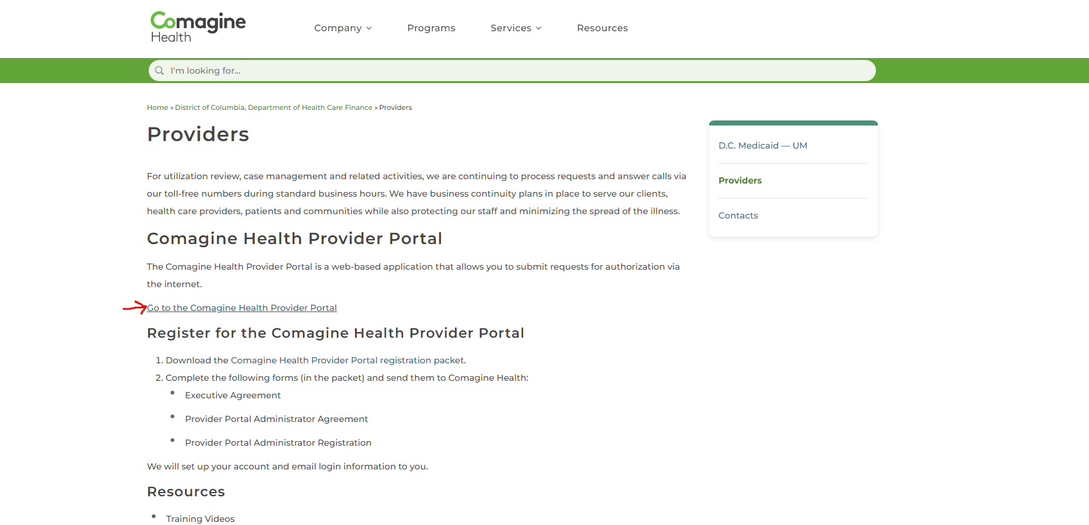
How to log into the Provider Portal
Click here to log in to the provider portal

Slide 20
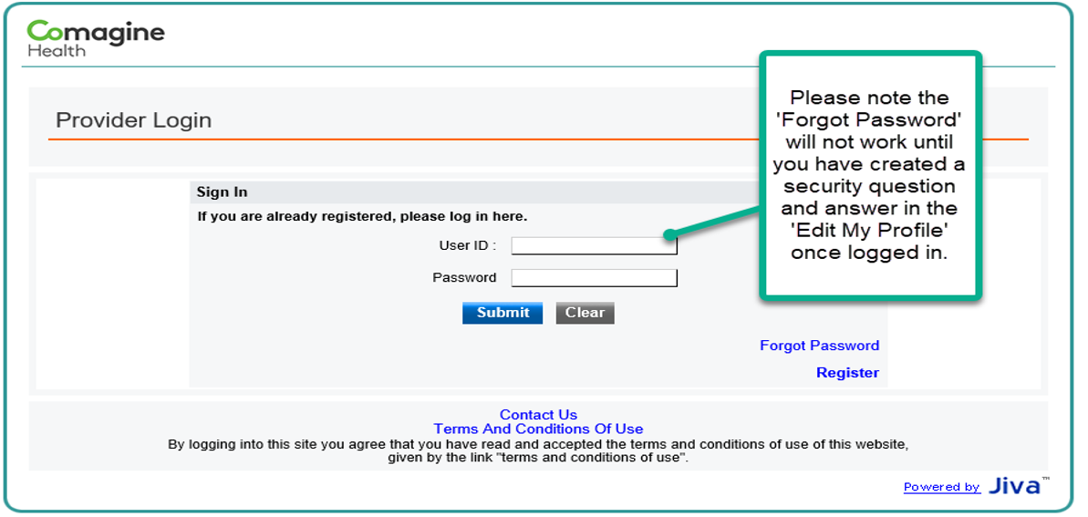
Provider Portal Log in

Slide 21
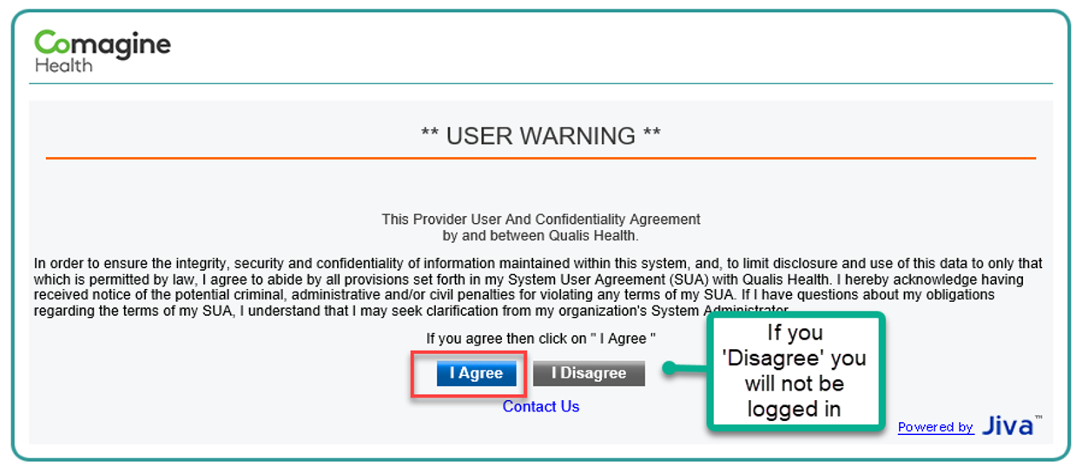
Provider User and Confidentiality Agreement

Slide 22
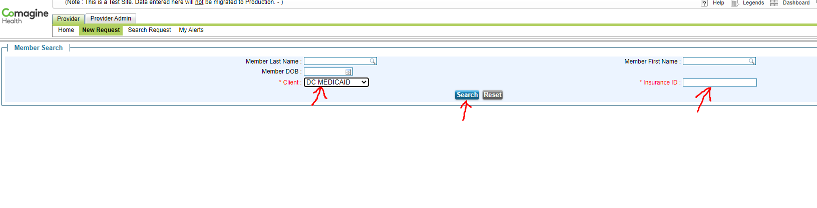
How to Start a Request
1. Select DC Medicaid
2. Enter the beneficiary’s DC Medicaid Number
3. Click the Search button

Slide 23
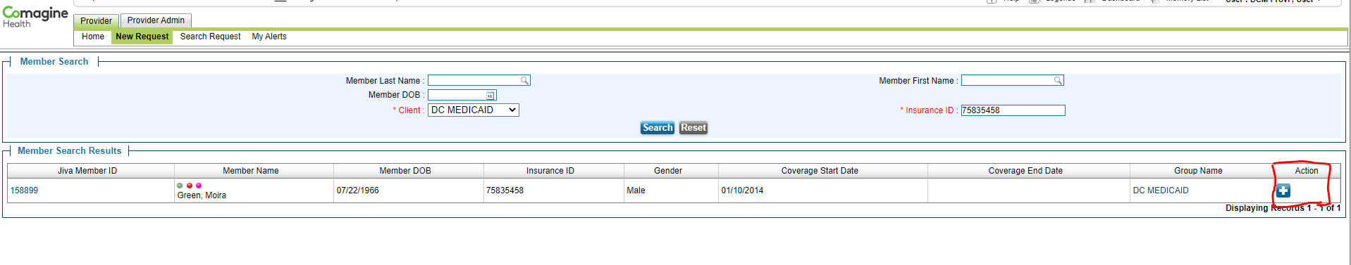
New Requests
The member will appear in the Member Search Results
Click on the Action icon on the far right of their name to begin a New Request

Slide 24
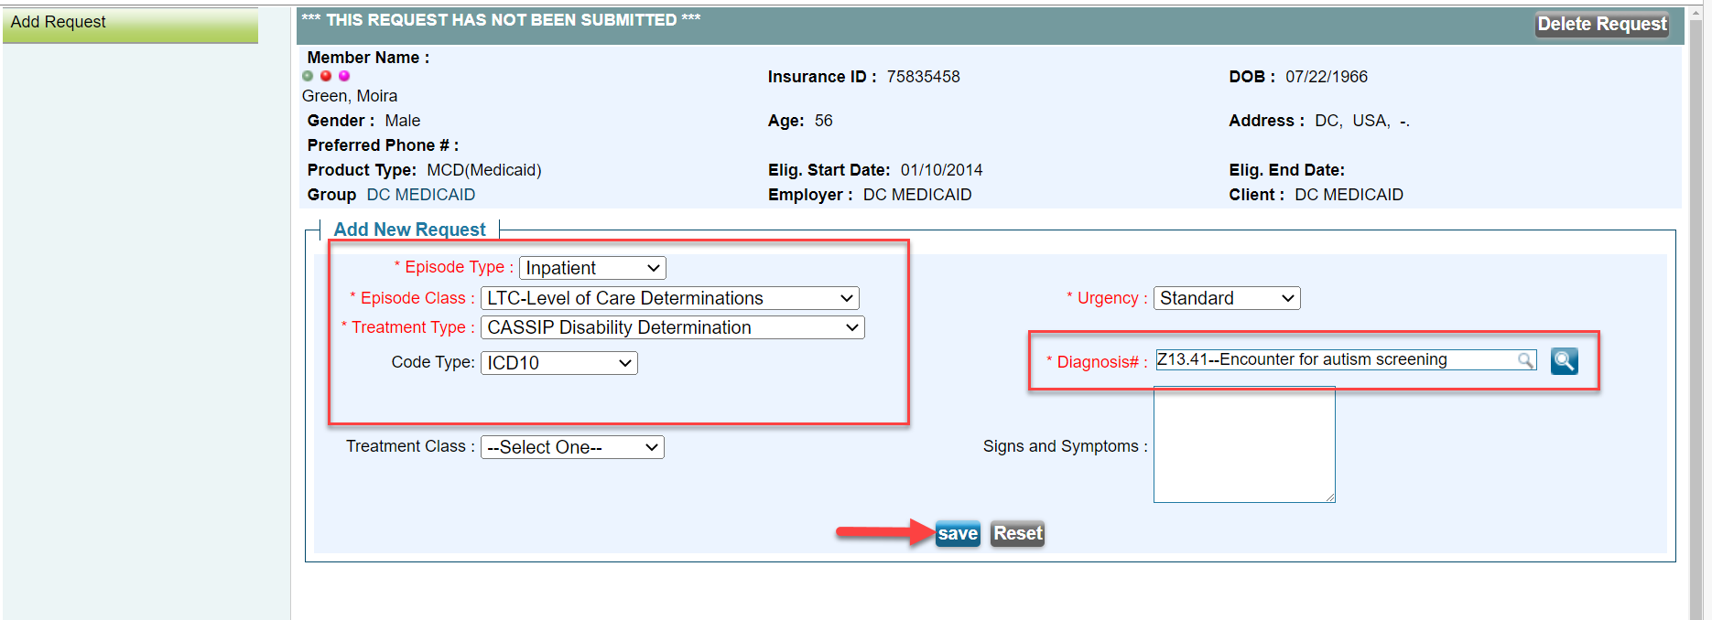
Creating a Request, part 1
Diagnosis –enter a ICD10 Diagnosis code or word search
Pick the Home Health Service you are requesting

Slide 25
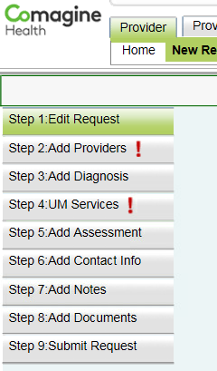
Working Steps to Submit a Request
Click on each tab in the left navigation panel to complete the steps.
Step 1 allows you to make edits
Complete all required steps for your individual request

Slide 26
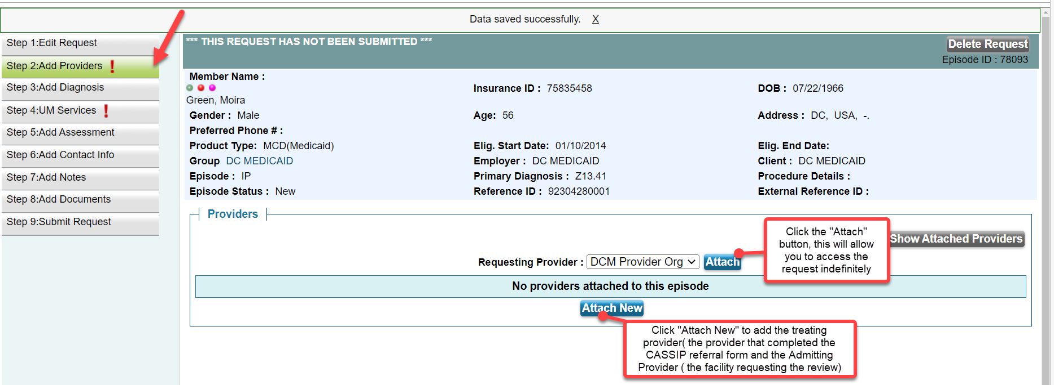
Working Steps to Submit a Request

Slide 27
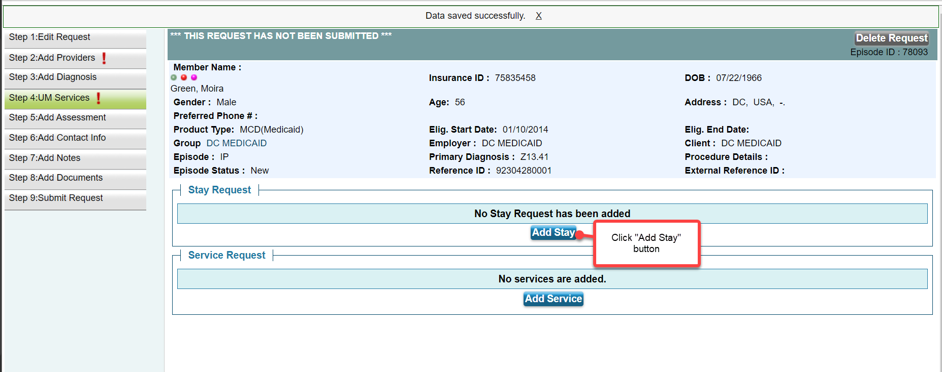
Working Steps to Submit a Request
Click “Add service” button

Slide 28
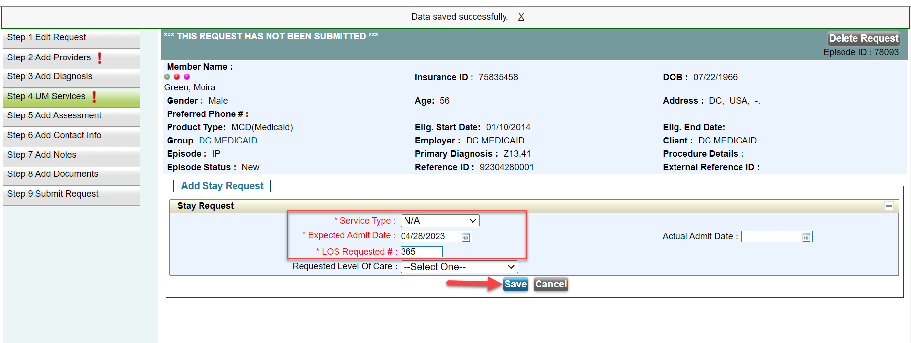
Working Steps to Submit a Request
Click “Add service” button

Slide 29
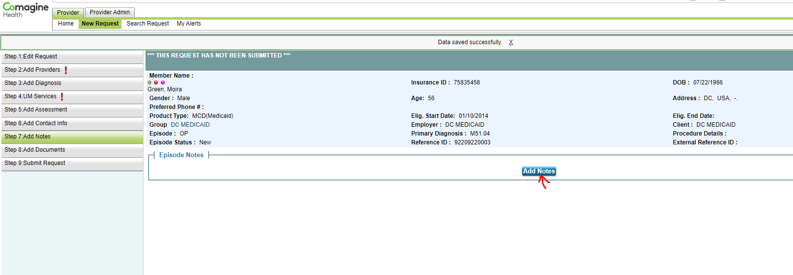
Working Steps to Submit a Request
Please add your contact information

Slide 30
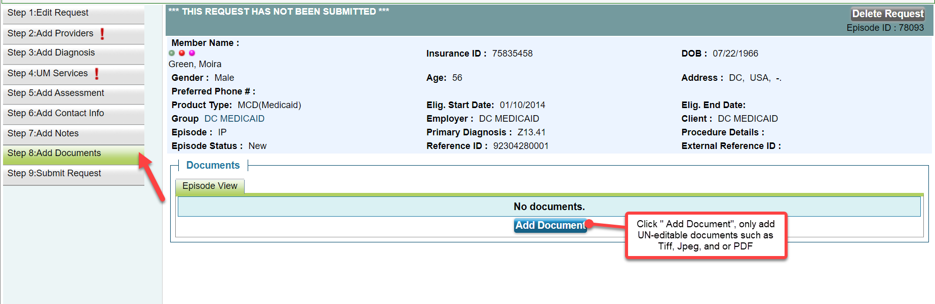
Working Steps to Submit a Request

Slide 31
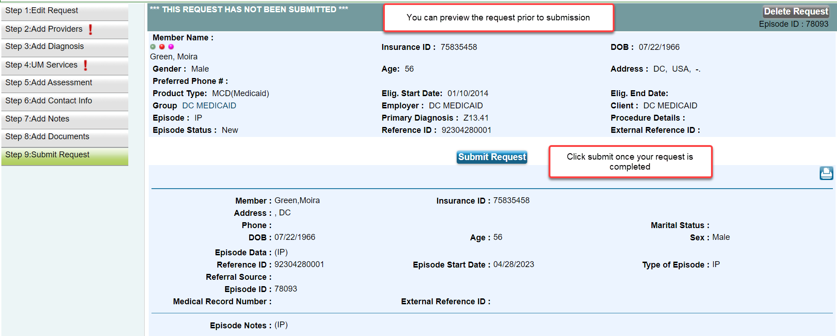
Working Steps to Submit a Request

Slide 32
How to Check on an Existing Request

Slide 33
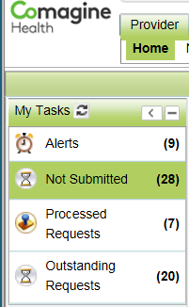
Dashboards and Alerts
Your dashboard will allow you to view your client/patients
To open a request, click on the ‘OP” or ‘IP’ icon
The episode number will give you an abstract view only
You can monitor your alerts for updates to the request

Slide 34
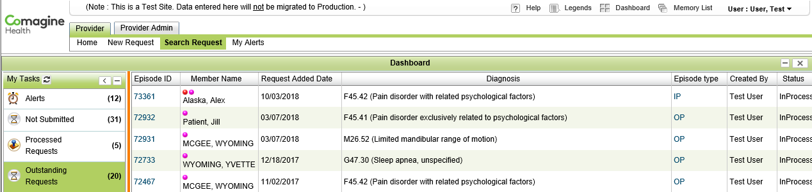
Provider Portal Dashboard and Alerts
Your dashboard will allow you to view your client/patient(s)
To open a request, click on the ‘IP or OP’ icon next to the person’s name
The episode number will give you an abstract view only
You can monitor your alerts for updates to the PA request

Slide 35
Operational Procedures
Submission
  All CASSIP disability determination requests must be electronically submitted by the provider directly through the secure portal used by Comagine or by fax-1-800-731-2314 or secure email- dccassipsubmission@comagine.org, DHCF’s contracted agent authorized to review and issue CASSIP disability determinations;
  b. To be processed, all disability determination requests must, at a minimum, contain
  a complete and accurate Provider Referral Form, and current medical records (documentation dated within six months) that demonstrate that the diagnosis(es) stated on the Form, either meet or equal a Listing, and meet the duration requirement;

Slide 36
Operational Procedures (continued)
  c. No later than 2 business days from the date of submission, Comagine will
  notify the sending Provider via their portal, of any non-clinical demographic
  information that is either missing or incorrect from the Provider Referral Form.
  Providers have 2 business days from receipt of the portal notification to
  produce or correct the outstanding non-clinical information. If the requisite non- clinical information is not received within 2 business days, then Comagine will issue a Technical Denial.

Slide 37
Operational Procedures (continued)
Disposition
There are three (3) possible outcomes for each CASSIP disability determination request: (1) Technical Denial, (2) Denial, and (3) Approval.
  Technical Denial: This disposition refers to requests with missing or incorrect non-clinical information on the Provider Referral Form. If the sending provider has not furnished the missing or incorrect information within 2 business days of portal notification, then Comagine will issue, no later than 8 business days from the date the request was received through its portal, a written notification to the subject beneficiary, that their request for disability determination was not processed, including the information required for processing. Comagine will concurrently issue a copy of the same notification to the sending provider and DHCF through the portal.

Slide 38
Operational Procedures (continued)
    Denial: This disposition is the result of a clinical finding that the information contained in the request did not meet the SSA criteria for “childhood disability.” No later than the 8th business day from receipt of the request, Comagine will issue a written notification to the subject beneficiary, that their request for disability determination was denied, including the specific basis for denial, and appeal rights. Comagine will concurrently issue a copy of the same notification to the sending provider and DHCF through the portal.
    Approval: This disposition is the result of Comagine finding that the subject beneficiary meets the SSA criteria for “childhood disability.” Written notification of all disability approval determinations will be issued for the subject beneficiary within 10 business days of receipt of a complete CASSIP disability determination request.

Slide 39
Operational Procedures (continued)
Reporting to DHCF
Comagine will maintain the following additional documents for purposes of quality monitoring and accountability:
  Clinical decision checklist for all denials and approvals - Comagine will complete and maintain a Clinical Decision Record Document for all denials and approvals. The record must be completed by the clinical decision-maker associated with each determination.
  Outcome Record indicating the outcome and disposition of all requests received are to be reported monthly and placed onto Comagine’s SFTP site.

Slide 40
Operational Procedures (continued)
DHCF Operational Functions
  External Correspondence: Comagine will serve as the point of contact regarding any external inquiries about the CASSIP Disability Determination process;
  Oversight and Monitoring: The Contract Administrator (CA) of the Comagine contract will lead oversight and monitoring efforts related to the CASSIP Disability Determination functions delegated to Comagine;
  HSCSN Enrollment: The Management Analyst within HCDMA will oversee timely enrollment and outreach efforts by HSCSN for all individuals approved for CASSIP enrollment based on the disability determination process.

Slide 41
Who to Call
If there are errors messages with the Comagine Health Provider Portal (CHPP)
Request to create a new member in the CHPP
Questions regarding Medical Necessity Denial or general questions
Comagine Health DC Office
Main # 1-800-251-8890
Review related question:
Ask to speak with the QIO Director Folasade Akinkuowo
Ask to speak with the Clinical manager Christan McNulty

Slide 42

This Photo by Unknown Author is licensed under CC BY

