Slide 1
The Six Building Blocks
A Team-Based Approach to Improving Opioid Management in Primary Care
The development team included:
Michael Parchman, MD, MPH
Kaiser Permanente Washington Health Research Institute (KPWHRI)
Laura-Mae Baldwin, MD, MPH
University of Washington
Kelly Ehrlich, MPH
KPWHRI
Nicole Ide, MPH
University of Washington
Brooke Ike, MPH
University of Washington
Doug Kane, MS
KPWHRI
Rob Penfold, PhD
KPWHRI
Kari Stephens, PhD
University of Washington
Mark Stephens, MA
Change Management Consulting
David Tauben, MD
University of Washington
Nicole Van Borkulo, MEd
KPWHRI
Michael Von Korff, ScD
KPWHRI
This work was funded by the Agency for Healthcare Research & Quality (R18HS023750), and the National Center For Advancing Translational Sciences of the National Institutes of Health (UL1TR000423). Additional funding comes from a WA OCH subcontract and a WA DOH subcontract (HED23124) of Cooperative U17CE002734, funded by the CDC. Its contents are solely the responsibility of the authors and do not necessarily represent the official views of CDC or the WA State Department of Health.

Slide 2
Agenda
Overview of the Six Building Blocks program
Why is this program important to us?
Small group discussions of our clinic’s current approach to long-term opioid management and priorities for change
Program next steps and how you can help

Slide 3
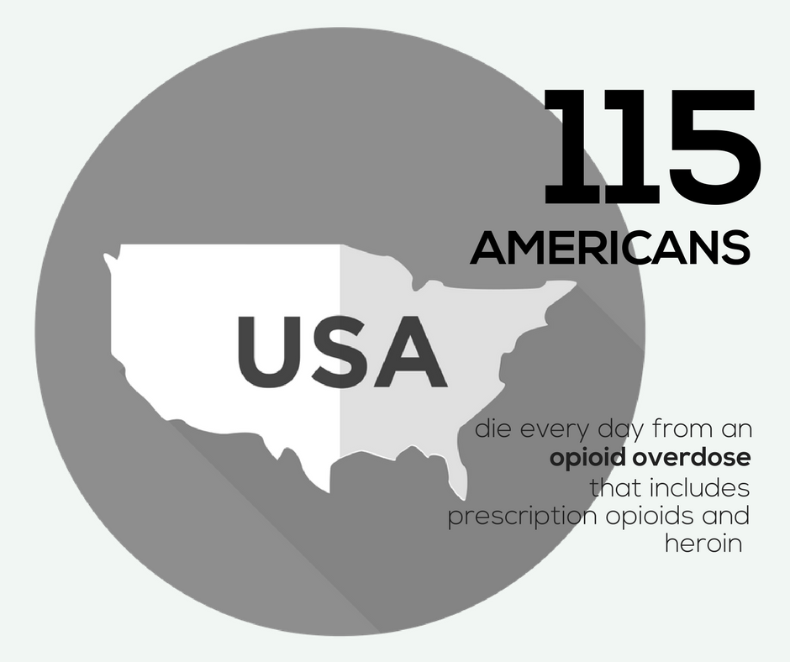
Notes:
https://www.cdc.gov/drugoverdose/epidemic/index.html

Slide 4
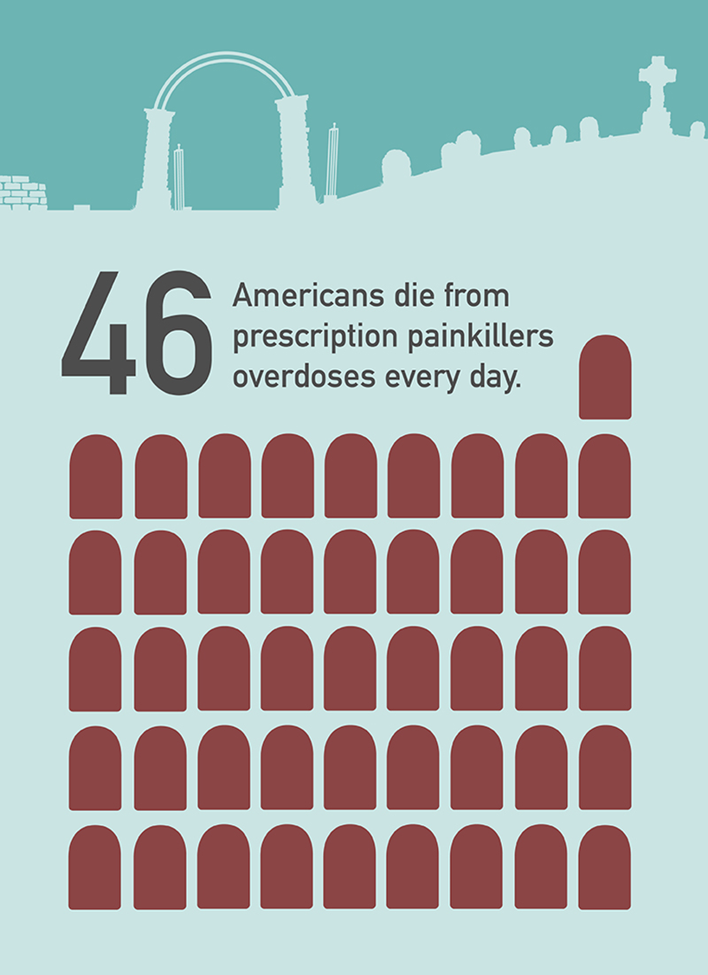

Slide 5
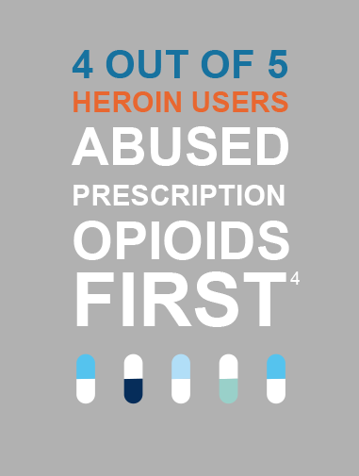

Slide 6
Opioid Overdose Risk
Dunn et al Ann Intern Med 2010

Slide 7
Top five medicines prescribed in the U.S. in 2016 were:
Levothyroxine (123 million Rx)
Lisinopril (110 million)
Atorvastatin (106 million)
Hydrocodone/acetaminophen (90 Million)
Metoprolol (88 million)
Notes:
https://www.iqvia.com/institute/reports/medicines-use-and-spending-in-the-us-a-review-of-2016

Slide 8
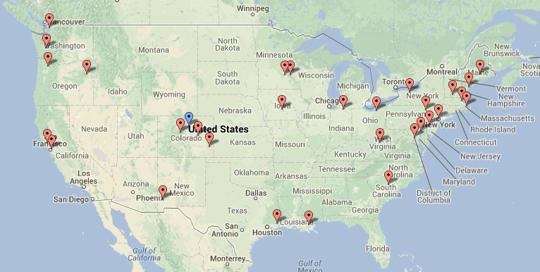
The Six Building Blocks derive from observations of approaches taken among 20 primary care practices across the U.S. that were identified as having exemplar, team-based workforce innovations.
Learning from Effective Ambulatory Practices (LEAP) study: http://www.jabfm.org/content/30/1/44.full#abstract-1

Slide 9
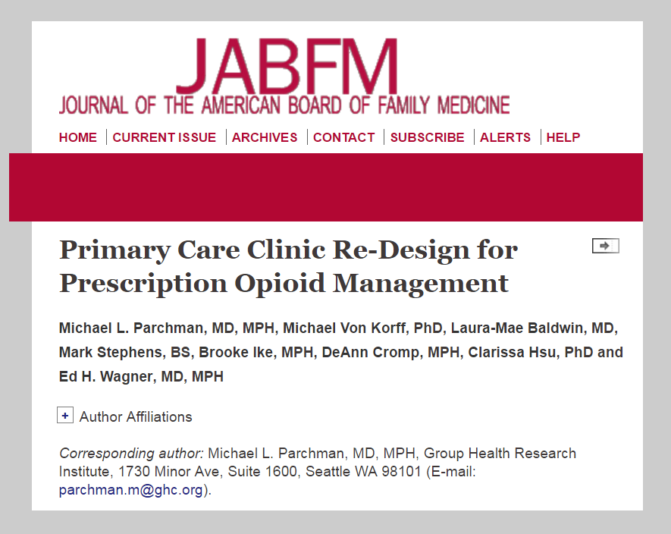
Learnings from these practices were organized into the Six Building Blocks of Safer Opioid Management and published in the Journal of American Board Family Medicine in February 2017.
Notes:
http://www.jabfm.org/content/30/1/44.full#abstract-1

Slide 10
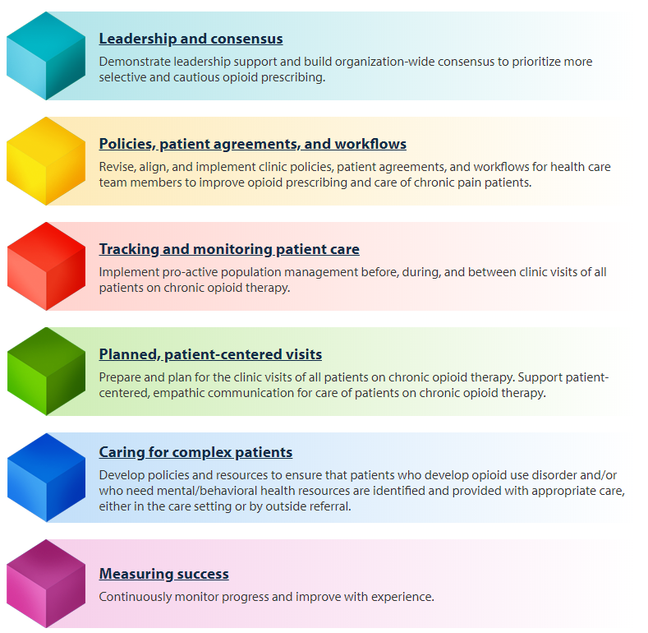
The Six Building Blocks

Slide 11
The Six Building Blocks

Slide 12
Team-Based Opioid Management in Primary Care
  Kaiser Permanente Washington Research Institute (KPWRI) and the University of Washington developed a facilitated program to guide primary care organizations in implementing the Six Building Blocks and tested implementation of the Six Building Blocks Program in 20 rural and rural-serving clinics.
Notes:
Best practices include:
-- implementation of policies and procedures that match with the CDC guidelines for opioid management
-- use of the PMP
-- UDT
-- referral of patients with OUD to treatment
-- avoidance of opioid and sedative co-prescribing
-- initiating difficult conversations with patients on high doses of opioids about tapering
Practice coach meets with practices quarterly and as needed to support the development and implementation of a practice “action plan.”
Practices learn from each other through monthly virtual learning collaborative calls
Coach connects patients with telepain conferences, which include short didactic presentations and case presentations of difficult cases with a multidisciplinary team of pain “experts”
Provides simple tools to assist with tracking opioid use and management.

Slide 13
Team-Based Opioid Management in Primary Care
The number of patients using chronic opioid therapy and the proportion on high-dose opioids decreased.

Slide 14
  What one clinician said about how he felt after implementing the Six Building Blocks project:
  “Having a defined care pathway for an emotionally charged and complex area of care — to walk in with a plan. It's like walking into the ER and someone having a cardiac arrest. Not the most stressful thing I do because we have a clear plan. Now I have the same kind of pathway for opioids. Having what we are going to do defined.”

Slide 15
What others said about clinic life after implementing the Six Building Blocks:
“Everybody that works in this clinic says to me, ‘do you remember how much turmoil there was around it? Wow, we don’t have any of that anymore.”
Medical Director
“Hopefully there’s no going back. It works. I don’t think any one of us wants to go back.”
Medical Assistant
“I saw one of the high MED patients that I inherited… we got him down to 80... just for him to say, ‘You know, I’m more functional — my pain is not different, might be better.”
Physician
“The teamwork, there’s been a lot of teamwork regarding it. I wouldn’t say that was a surprise, but it’s been nice.”
Nurse

Slide 16
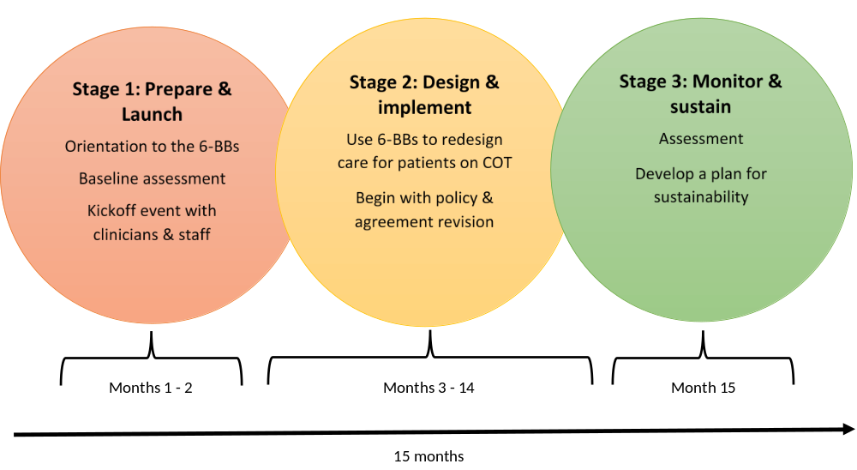
Stages of Six Building Blocks Implementation

Slide 17
Why This Project is Important
Insert Slides

Slide 18
Data and Stories
Insert slides

Slide 19
Where are we now?
A time for reflection and discussion

Slide 20

Diverse Perspectives
First step: gather an accurate
baseline picture
Different roles and
clinics = different perspectives
It is essential to get a sense of these different understandings to help build consensus & inform the quality improvement initiatives.

Slide 21
Self-Assessment Activity Directions
Each group will start on a different page, then continue and complete as many sections as time allows.
As a group, please review each question and circle the number that best reflects your organization’s current status. Answers should reflect the clinic as a whole — not your individual practice.
There are three number options for each answer to allow you to select how far along you are within that answer. If your group cannot agree, mark both scores and make a note.
There are no right or wrong answers; we just want to gather perspectives from across the clinic and across roles.
If you finish the whole assessment, proceed with the challenges & successes discussion guide on page 8.
Prepare to share your scores and discussion points with the other groups.
Time: 30 minutes
Notes:
*Give directions BEFORE breaking into groups*
Emphasize that they should consider the clinic as a whole, not their individual practices. Also, answer the questions based on what’s been going on in the past 3 months, not taking into account the recent focus on this issue.
4-5 people per group
Each group will start with a different BB and finish as many as they can in 30 minutes
(TELL THEM ABOUT THE SURVEY WHEN 10 MIN LEFT) If you need to leave, please turn in your survey on your way out.)

Slide 22
Small-Group Baseline
Self-Assessment Results

Slide 23
Leadership & Consensus
Leadership prioritizes the work | 1 2 3 | 4 5 6 | 7 8 9 | 10 11 12
The commitment of leadership in this clinic to improving management of patients on chronic opioid therapy… | …is not visible or communicated. | …is rarely visible, and communication about use of opioids for chronic pain patients is ad hoc and informal. | …is sometimes visible and communication about patients on chronic opioid therapy is occasionally discussed in meetings. | …is communicated consistently as an important element of meetings, case conferences, emails, internal communications, and celebrations of success.
Shared vision | 1 2 3 | 4 5 6 | 7 8 9 | 10 11 12
A shared vision for safer and more cautious opioid prescribing… | …has not been formally considered or discussed by clinicians and staff. | …has been discussed, and preliminary conversations regarding a clinic-wide opioid prescribing standard have begun. | …has been partially achieved, but consensus regarding a clinic-wide opioid prescribing standard has not yet been reached. | …has been fully achieved. Clinicians and staff consistently follow prescribing standards and practices.
Responsibilities assigned | 1 2 3 | 4 5 6 | 7 8 9 | 10 11 12
Responsibilities for practice change related to patients on chronic opioid therapy… | …have not been assigned to designated leaders. | …have been assigned to leaders, but no resources have been committed. | …have been assigned to leaders with dedicated resources, but more support is needed. | …have been assigned. Dedicated resources support protected time to meet and engage in practice change.
Notes:
Each group presents on their findings. 20 minutes. Keep in mind about 3 minutes per slide.
Each group will report on the section they started with, how they scored themselves and why. Next ask audience if that resonated with them or if they have a different experience they want to share.
In presenter view, you can mark/circle the answers on the slide.

Slide 24
Policies, Patient Agreements, and Workflows
Policy development/ revision | 1 2 3 | 4 5 6 | 7 8 9 | 10 11 12
Comprehensive policies regarding chronic opioid therapy that reflect evidence-based guidelines, such as the CDC Guideline for Prescribing Opioids for Chronic Pain or state-based opioid prescribing guidelines… | …do not exist. | …exist, but have not been recently revised and updated. | …exist, have been recently updated, but are still lacking essential components. | …exist, and have been recently updated to reflect recent evidence-based guidelines, and are comprehensive.
Policy Implementation | 1 2 3 | 4 5 6 | 7 8 9 | 10 11 12
Policies regarding chronic opioid therapy… | …have not been distributed to clinicians and staff. | …have been distributed to clinicians and staff, but have not been discussed. | …have been distributed, have been discussed with all clinic staff and clinicians, but are not consistently followed. | …have been distributed, have been discussed with all clinic staff and clinicians, and are consistently followed.
Patient agreements | 1 2 3 | 4 5 6 | 7 8 9 | 10 11 12
Formal signed patient agreements regarding chronic opioid therapy… | …do not exist. | …exist, but do not align with current clinic policies and/or are not consistently used | …exist, align with current clinic policies, but are not consistently used. | …exist, align with current policies, and are consistently used with all patients on chronic opioid therapy.
Workflows | 1 2 3 | 4 5 6 | 7 8 9 | 10 11 12
Clinic workflows for managing patients on chronic opioid therapy… | …do not exist. | …exist, but do not support current clinic policies. | …exist, support current clinic policies, but are not fully implemented. | …exist, support current clinic policies, and are fully implemented

Slide 25
Tracking and Monitoring Patient Care
Tracking & monitoring of patients prescribed chronic opioids | 1 2 3 | 4 5 6 | 7 8 9 | 10 11 12
Use of a system to pro-actively track & monitor patients prescribed chronic opioids to ensure their safety… | …has not been explored or is not possible with existing data systems. | …is technically possible, but systems to get useful reports are not yet in place. | …is possible and systems are in place to produce basic reports on a regular basis. | …is possible, systems are in place, and reports are produced that allow for tracking of patient care and monitoring of clinician practices.
Tracking & monitoring data collection workflows established | 1 2 3 | 4 5 6 | 7 8 9 | 10 11 12
Workflows to enter data into the tracking & monitoring system… | …have not been developed. | …are in development, but not established. | …are established, but aren’t consistently implemented. | …are established and consistently implemented. Responsibilities are assigned and protected time is available to complete assigned responsibilities.
Tracking & monitoring data use workflows established | 1 2 3 | 4 5 6 | 7 8 9 | 10 11 12
Workflows to use data to track patient care and monitor clinician practices… | …have not been developed. | …are in development, but not established. | …are established, but aren’t consistently implemented. | …are established and consistently implemented. Responsibilities are assigned and protected time is available to complete assigned responsibilities.

Slide 26
Planned, Patient-Centered Visits
Planned opioid patient visits | 1 2 3 | 4 5 6 | 7 8 9 | 10 11 12
Before routine clinic visits, patients on chronic opioid therapy… | …are not identified. There is no advance preparation for patient visits for chronic opioid therapy. | …are sometimes identified, but there is no discussion or advance preparation for visits with patients prescribed chronic opioids. | …are identified, and a discussion or chart review to prepare for the visit sometimes occurs. | …are consistently identified and discussed before the visit. The chart is reviewed and preparations made to address safe opioid use.
Empathic communication | 1 2 3 | 4 5 6 | 7 8 9 | 10 11 12
Training on patient-centered, empathic communication emphasizing patient safety, e.g., opioid risks, dose escalation, and to tapering… | …has not been offered to clinicians and staff. | …has been offered to clinicians and staff, but there was limited participation. | …has been offered and the majority of clinicians and staff participated. | …is consistently offered with widespread, regular participation.
Patient involvement | 1 2 3 | 4 5 6 | 7 8 9 | 10 11 12
Training on how to involve patients on chronic opioid therapy in decision-making, setting goals for improvement and providing support for self-management… | …has not been offered to clinicians and staff. | …has been offered to clinicians and staff, but there was limited participation. | …has been offered and the majority of clinicians and staff participated. | …is consistently offered with widespread, regular participation.
Care plans | 1 2 3 | 4 5 6 | 7 8 9 | 10 11 12
Chronic are care plan templates for chronic pain management… | …do not exist. | …exist, but do not align with current clinic policies and/or are not consistently used | …exist, align with current clinic policies, but are not consistently used. | …exist, align with current policies, and are consistently used.
Patient Education | 1 2 3 | 4 5 6 | 7 8 9 | 10 11 12
Patient education materials that include explanation of the risks, and limited benefits of long-term opioid use… | …do not exist. | …exist, but strategies to disseminate to patients do not exist. | …exist and dissemination strategies exist, but the strategies have not been fully implemented. | …exist, dissemination strategies exist, and the strategies have been fully implemented.

Slide 27
Caring for Complex Patients
Identifying complex patients | 1 2 3 | 4 5 6 | 7 8 9 | 10 11 12
Policies, clinic-selected screening tools, and workflows to identify opioid misuse, diversion, addiction, and to recognize mental/behavioral health needs… | …do not exist. | …partially exist. | …exist, but are only partially implemented. | …exist and are consistently implemented.
Behavioral health resources | 1 2 3 | 4 5 6 | 7 8 9 | 10 11 12
Mental/behavioral health services… | …are difficult to obtain reliably. | …are available from behavioral health specialists but aren’t timely or convenient. | …are available from behavioral health specialists and are usually timely and convenient. | …are readily available from behavioral health specialists who are onsite or who work in an organization that has a referral protocol or agreement with our practice setting.

Slide 28
Measuring Success
Monitoring progress | 1 2 3 | 4 5 6 | 7 8 9 | 10 11 12
A system to measure and monitor progress in opioid therapy practice change… | …does not exist. | …exists, including overall tracking goals, but regular tracking reports on specific objectives have not been produced. | …is used to produce regular tracking reports on specific objectives. Leadership reviews are done occasionally, but not on a formal schedule. | …has been fully implemented to measure and track progress on specific objectives. Leadership reviews progress reports regularly and adjustments and improvements are implemented.
Assessing and modifying | 1 2 3 | 4 5 6 | 7 8 9 | 10 11 12
Adjustments to achieve safer opioid prescribing based on monitoring data… | …are not being made. | …are occasionally made, but are limited in scope and consistency. | …are often made and are usually timely. | …are consistently made and are integrated in overall quality improvement strategies.

Slide 29
Now the Work Begins!
This is an all-clinic, team process
Opioid Improvement Team will create a plan to move forward
You will have a chance to participate in clinical education opportunities. Feel free to get started right away!
Notes:
The clinic will be updating some policies and patient agreements…you might be engaged in providing feedback for the development and implementation of these…

Slide 30
Other Resources
CDC patient education
Difficult conversations and scripts for providers and staff
VA opioid taper decision tool
Tips for managing legacy patients
Additional resources on the website
Six Building Blocks website
comagine.org/program/six-building-blocks
Questions?
Notes:
COLLECT SURVEY AT END
UPDATE THE RESOURCES

Slide 31
Opioid Improvement
Team Meeting
Notes:
Bring up website on the computer

Slide 32
Agenda
Decide on milestones
Decide on a measure of success
Develop first action plan
      Leadership and consensus
      Policies and patient agreement
      Tracking & monitoring, if within capacity
      Other work, as desired
Plan future meetings
Discuss the work that occurs in between action plan meetings

Slide 33
Decide on Milestones
  Reflect on:
  Our learnings from the baseline assessment process
  Experiences and priorities of clinicians and staff
Notes:
What did you hear were the key challenges for providers and staff?
What did you hear were the key priorities for providers and staff?

Slide 34
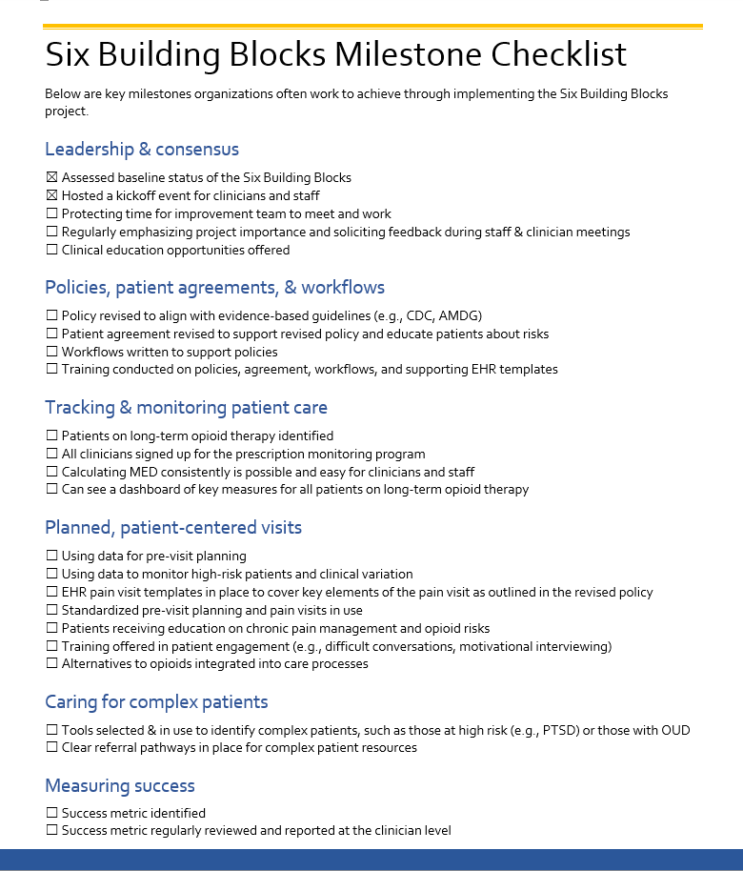
Notes:
These are the milestones organizations often work toward achieving. Considering what we learned through the baseline assessment and from feedback from clinicians and staff, what are top priorities? Is there anything missing? Anything we do not want to do?

Slide 35
Decide on a Measure of Success
Decide on a metric to regularly track, monitor, and share with clinicians and staff that is:
Important to you
Feasible to measure
Notes:
One very important aspect of a project like this is to make sure you are monitoring success over time in an aspect of clinical care that really matters to you. An important part of QI.
Based on what you are trying to achieve through implementing the 6 Building Blocks, let’s consider potential metrics you can use to assess success. It is motivating both to you as a team and to the clinic as a whole to see how a metric that you choose changes over time. Whatever metric you select, we encourage you to share it during staff and clinician meetings.
You might look at the below list and think, all of these are important to us! All of these should improve as you implement the 6 Building Blocks. However, it also takes effort and resources to conduct these measurements, so we suggest that you select just one to measure at first. You can add to it over time as your capacity to track grows.
What metric is both important to your organization AND reasonable to measure with your existing resources?
Distribute handout of the suggested metrics

Slide 36
Decide on a Measure of Success
XX% of patients on COT have reviewed and signed an updated patient agreement that reflects our policies by this DATE.
Have the capacity to provide a dashboard of measures that track our improvement, e.g., MED average and by patient, to the opioid improvement team and to clinicians and staff quarterly by DATE.
By DATE, identify care gaps for all patients on COT and discuss them during morning huddles, e.g., no PMP check in the last 6 months.
Develop, train, and implement new workflows that support our revised policies by DATE.
Have an MED on record for all patients on chronic opioid therapy by DATE.
Reduce the number of patients with an MED of 50/90 or higher by XX% by DATE.
Reduce the number of patients on concurrent sedatives and opioids by XX% by DATE.

Slide 37
Let’s create our first action plan!
First goals?
Clear, attainable steps
Who is responsible
When it will be done by
Resources to support the work

Slide 38
Common First Goals
Protecting time for improvement team to meet and work
Regularly emphasizing project importance and soliciting feedback during staff and clinician meetings
Clinical education opportunities offered to team, staff, and providers
Policy revised to align with evidence-based guidelines
Patient agreement revised to support revised policy & educate patients about risks
Patients on long-term opioid therapy identified
All clinicians signed up for the WA PDMP
Calculating MED consistently is possible and easy for clinicians

Slide 39
Resources
comagine.org/program/six-building-blocks
Notes:
Pull up the website and show resource page and the implementation guide sections

