Slide 1
Six Building Blocks Introduction
A Team-Based Approach to Improving
Opioid Management in Primary Care
Notes:
Our organization is offering a program called the Six Building Blocks to clinics. This program offers an opportunity for primary care clinics to apply a team-based approach to improving opioid management for patients with chronic pain.

Slide 2
Agenda
Introductions
What are the Six Building Blocks?
Types of Six Building Blocks support available
What do clinics need to be successful?
Learning more about your organization
Next steps
Notes:
Through this presentation, I’ll share a background on the Six BBs program, why your clinic might want to join this effort, what your clinic would need to have in place to succeed with the Six BBs program, and ask whether you’d like to take part in this program.

Slide 3

Overdose Fatalities
130
Americans
die every day from an
opioid overdose
that includes
prescription opioids
and heroin
Notes:
I want to start by reminding us why working to improve opioid management is so important. 130 Americans…
https://www.cdc.gov/drugoverdose/epidemic/index.html

Slide 4
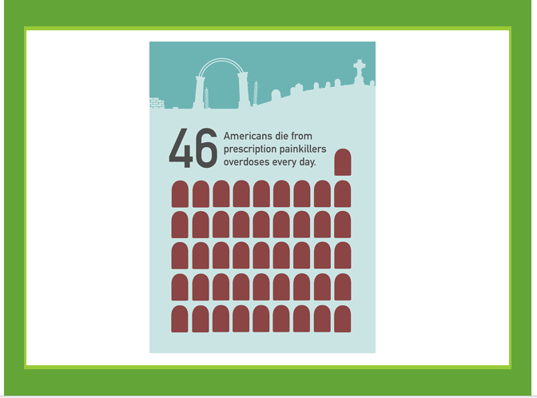
Notes:
Roughly 46 people die every day from overdoses involving prescription opioids www.cdc.gov/drugoverdose/data/overdose.html
https://www.cdc.gov/mmwr/volumes/67/wr/mm675152e1.htm?s_cid=mm675152e1_w
This article shows that 36% of opioid-related overdose deaths in 2017 involved prescription opioids.

Slide 5
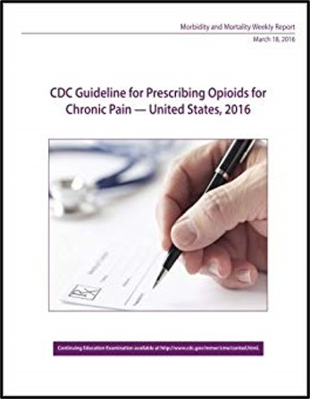
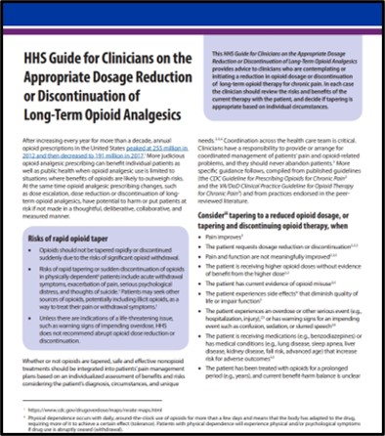
National Guidelines to Provide Support
Notes:
There have been national efforts to support providers and patients. For example:
CDC Guidelines
HHS taper guide
[FYI Notes on CDC Guidelines:
Prevent long term opioid use:
Opioids are not first-line therapy
Use immediate-release opioids when starting
Prescribe short durations for acute pain
For patients using opioid therapy:
Establish goals for pain and function
Discuss risks and benefits
Use the lowest effective dose
Evaluate benefits & harms frequently
Use urine drug testing
Review PDMP data
Use strategies to mitigate risk
(e.g., naloxone)
Avoid concurrent opioid & sedative prescribing
Offer treatment for Opioid Use Disorder]

Slide 6
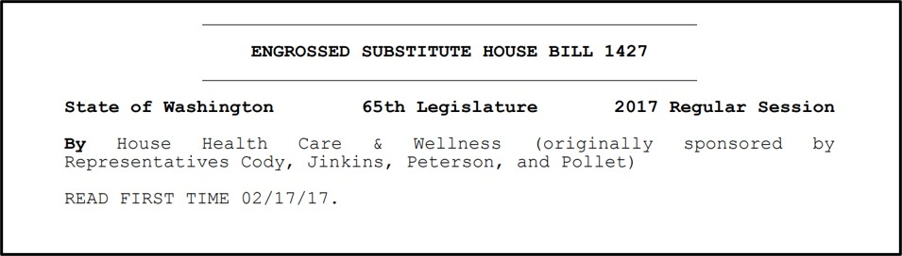
State and Local Efforts to Provide Support
Notes:
And state and local efforts:
For example, WA 1427 provides “bumpers” to help providers and patients
[FYI notes on 1427 :
Register with the PDMP: Prescription Drug Monitoring Program
Provide information on opioid risks, safe storage, and disposal; document that you provided this information
No prescribing of opioids if patient is using a sedative without documentation of risks, consultation with prescriber of sedative, and consideration of tapering
Ensure high risk patients have naloxone
Base your frequency of visits, PDMP checks, urine drug tests on patient risk status
Encourages care of patients with legacy prescriptions]

Slide 7

The Six Building Blocks
Supporting clinics in implementing
best practices for opioid management
Notes:
It can help to have support when aligning with guidelines and regulations. That’s what the Six Building Blocks does… provides support to match a practice’s opioid management improvement goals.

Slide 8
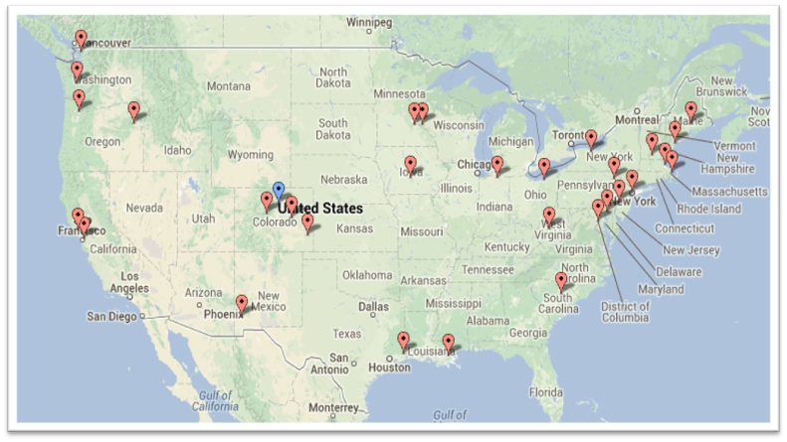
Best Practices Inform Opioid Management Program
The Six Building Blocks are derived from observations of approaches taken among 20 primary care practices across the U.S. that were identified as having exemplar, team-based clinical interventions.
Learning from Effective Ambulatory Practices (LEAP) study: http://www.jabfm.org/content/30/1/44.full#abstract-1
Notes:
Where did the Six Building Blocks program come from?
A team from the MacColl Institute at the Kaiser Permanente Washington Health Research Institute was funded by the Robert Wood Johnson Foundation to spend a week with primary care practices in both rural and urban locations across the U.S. that were identified as exemplary in their provision of team-based care. This slide shows the locations of these practices. During these visits, the MacColl team noticed that they were applying their skills in team-based care to address opioid management for their patients with chronic pain.
The MacColl team took extensive field notes over the week that they were visiting each of these practices, and a collaborative team from the MacColl Center and the University of Washington took the learnings from these field notes and identified common ways that these practices were addressing opioid management. This team organized the learnings from these practices into the Six Building Blocks for Improved Opioid Management, and published these in the Journal of the American Board of Family Medicine.

Slide 9
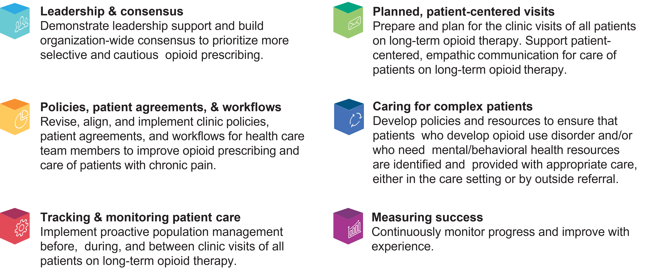
The Six Building Blocks
Notes:
These are the Six Building Blocks that were developed from these field notes.
Leadership and consensus. The exemplar practices each had support from their leadership for improving opioid management, and built organization-wide consensus to prioritize more selective and cautious opioid prescribing.
Policies, patient agreements, and workflows. All of the practices revised their clinic policies and patient agreements related to opioid management, and made sure that these aligned and that they had workflows that would support the implementation of the policies and agreement.
Tracking and monitoring patient care. Many practices don’t know who their patients with chronic pain using long-term opioid therapy are. These exemplar clinics all found ways to identify their patients, then track and monitor the care they were receiving. In this way they could pro-actively manage the population of their patients with chronic pain using long-term opioid therapy, both before, during and in between clinic visits.
4. Planned, patient centered visits. These exemplar practices were routinely preparing and planning for the clinic visits of all patients using long-term opioid therapy, through strategies like huddles. The practices also provided training opportunities for their providers and staff on how to communicate in patient-centered, empathic ways, since there can be significant stigma attached with use of long-term opioid therapy, and the work these practices were doing was likely to result in conversations that might be challenging (for example, around tapering opioid medications)
5. Caring for complex patients. Many patients with chronic pain who are using long-term opioid therapy have other conditions – mental health disorders like depression, anxiety, PTSD, and some (up to 25%) have opioid use disorder. So these exemplar practices made sure that they had resources in place to provide treatment for these mental health conditions and opioid use disorder (e.g., referral capabilities to behavioral health providers, offering suboxone therapy themselves)
6. Finally, the exemplar clinics all chose metrics that they followed to make sure that they were monitoring their success as they implemented their programs, and if they weren’t reaching their goals, they could make adjustments in their programs.

Slide 10
Support Provided Along the Way
Clinic-wide kickoff to facilitate discussions on the Six Building Blocks self-assessment
Ongoing guidance from a practice coach to support the opioid improvement team in developing and implementing action plans
Provision of resources: Policy, patient agreement, workflows, tracking approaches, patient education, etc.
Notes:
A program was tested in 6 organizations with 20 clinics to see if offering facilitated support could help clinics implement improvements within the 6 Building Block areas. Support included…

Slide 11
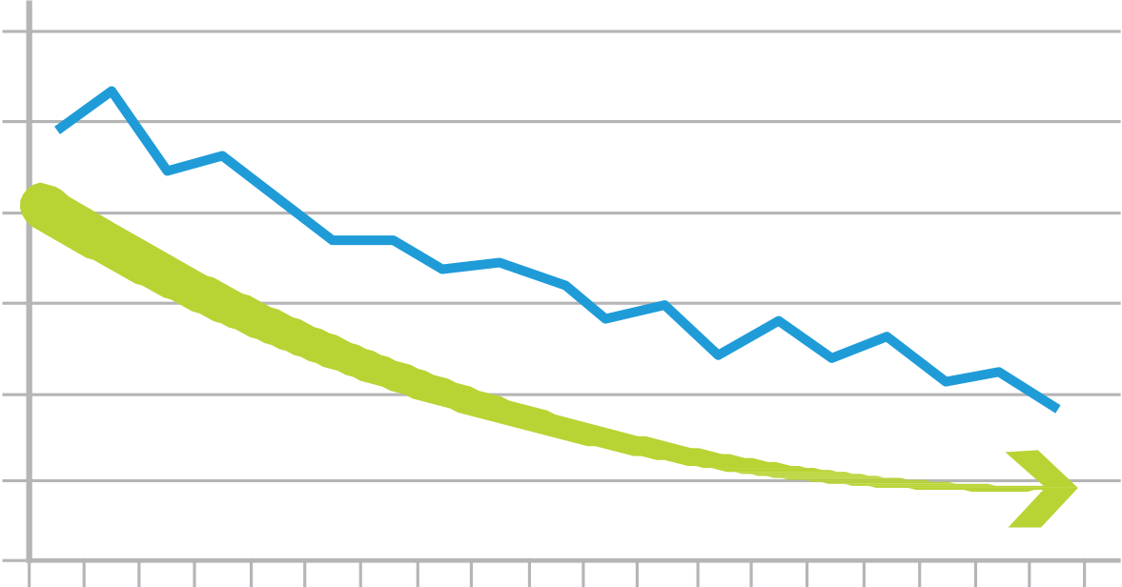
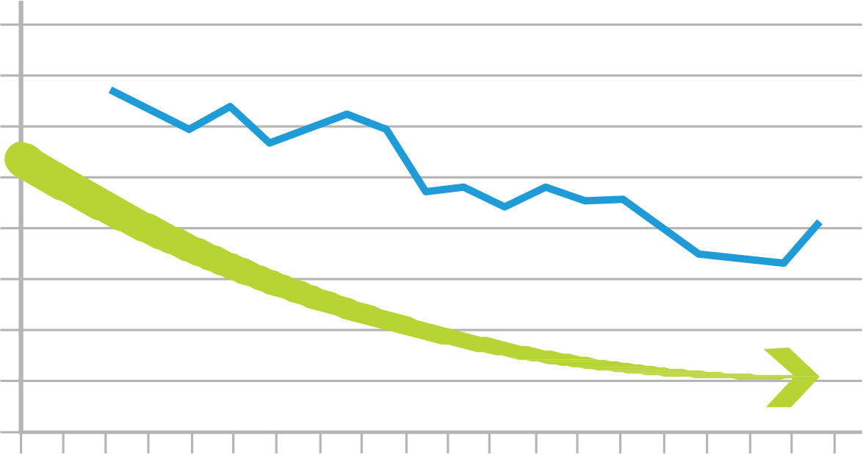
Prescribing Outcomes
“I feel like our patients are safer and there’s less disruption in the practice.” –Physician
The number of patients using long-term opioid therapy (LtOT) and the proportion on high dose opioids decreased.
Number of LtOT Patients
Percent on High Dose (MED ≥ 100)
2100
14%
2000
13%
12%
1900
11%
1800
10%
9%
1700
8%
1600
7%
1500
6%
Time
Time
http://www.annfammed.org/content/17/4/319.long
Notes:
The study found that the Six Building Blocks facilitated program was successful! The number of patients on long-term opioid therapy decreased along with the percent of patients on high dose opioids.

Slide 12
Clinician and Staff Experiences
Improved work life:
Increased confidence and comfort in caring for patients with chronic pain
Increased collaboration and teamwork across the clinic
Decreased stress in providing care to patients using long-term opioid therapy
Improved relationships with patients using long-term opioid therapy
  Seeing patients were receptive to change
  Fewer negative interactions
https://www.jabfm.org/content/32/5/715.abstract?etoc
Notes:
In addition, clinicians and staff reported that they felt like their work life improved through implementing the Six Building Blocks. They had increased confidence and comfort in caring for patients with chronic pain, noticed increased collaboration and teamwork, felt less stress in caring for these patients, and felt like their relationships with these patients improved.
These were terrific results. The staff felt better about their work life and decreased stress, increased comfort and improved relationships can increase the likelihood of a therapeutic alliance that minimizes stigmatization of patients with chronic pain using LtOT

Slide 13
Six Building Blocks Clinician and Staff Experiences
"Having a defined care pathway for an emotionally charged and complex area of care - to walk in with a plan. It's like walking into the ER and someone having a cardiac arrest. Not the most stressful thing I do because we have a clear plan. Now I have the same kind of pathway for opioids. Having what we are going to do defined.”
  “Everybody that works in this clinic says to me, ‘Do you remember how much turmoil there was around it? Wow, we don’t have any of that anymore.’”
  “The thing that surprised me was the number of patients that once they started churning through the standard care pathway, that said, ‘Wow, I get it,’ and then a lot of them just ended up tapering themselves ahead of us. I just wasn't quite prepared to see the patients engage.”
Notes:
These are some of the many quotes from both providers and staff about the benefits of the Six Building Blocks on their work life in the clinic.

Slide 14
We can offer different types of Six Building Blocks support to meet you where you are in efforts to improve opioid management
Notes:
I’d now like to talk about the kinds of facilitated support we can offer, depending on where your clinic is in chronic pain and opioid management improvements.

Slide 15
Comprehensive Six Building Blocks Program
Stage 1: Prepare & Launch
Learn about evidence, guidelines & regulations
Form a team & build leadership support
Conduct a baseline assessment
Identify priorities
Generate clinic enthusiasm
Stage 2: Design & Implement
Use Six Building Blocks to redesign care for patients on opioid therapy
Begin with policy & agreement revision
Throughout the design & implementation process: test, assess & adjust
Stage 3: Monitor & Sustain
Assess and celebrate progress from baseline
Develop a plan for sustainability
Site independently continues the work
Months 1 - 6
Months 4 - 14
Final month
9-15 months
Notes:
First, there is the evidence-based traditional model used to implement chronic pain and opioid management improvements in the Six Building Blocks areas.
The process involves 3 stages with activities within those stages tailored to the needs of your organization
DISCUSS EACH STAGE ACTIVITIES
A practice facilitator would work with the opioid improvement team your clinic builds to guide you through this process

Slide 16
Time Commitment by the Opioid Improvement Team for Full Six BB Framework Training Curriculum
Project manager: 2-8 hours per month
Clinician champion: 2-4 hours per month
Tracking and monitoring lead: Time spent depends on EHR system, measures chosen, etc.
Other team members (e.g., medical assistant, behavioral health provider, pharmacist): 2 hours per month
Notes:
The opioid improvement team generally includes
A staff lead/project manager (often the person in the clinic responsible for quality initiatives). This person will drive the program in your clinic, and should be someone who others in the clinic will pay attention to. This could be a quality improvement staff member, a head nurse, a clinic manager.
A clinician champion. This is usually a physician who is committed to this topic and is willing to provide clinical leadership to the project.
A tracking and monitoring lead. This is the person who will help establish how many patients using long term opioid therapy are cared for in the clinic, and will help the clinic track these patients, and ideally pull EHR data to measure outcomes such as proportion of patients using long term opioid therapy with a patient agreement in place, percent of patients using opioids and sedatives, percent of patients using high dose opioid therapy.
Some clinics include other team members, such as behavioral health providers, pharmacists, medical assistants
This slide indicates the range of hours that personnel from our clinics have spent on the Six Building Blocks program

Slide 17
Factors That Will Help Your Clinic Succeed in Implementing the
Six Building Blocks
You have identified opioids as an area of concern and prioritized it as an area to work on.
Your clinic leadership is supportive of making system-based improvements to managing chronic pain and opioid prescribing.
You have a staff member with quality improvement skills and experience who is interested in leading these improvements.
You have a clinician or champion who is passionate about improving the care of patients with chronic pain using long-term opioid therapy and has some time to dedicate to the work.
Notes:
If your clinic would like to consider implementing the Six Building Blocks, here are some factors that will support your clinic in doing so:
You have identified opioids as an area of concern and prioritized it as an area to work on.
Your clinic leadership is supportive of making system-based improvements to managing chronic pain and opioid prescribing
You have a staff member with quality improvement skills and experience who is interested in leading these improvements.
You have a clinician or champion who is passionate about improving the care of patients with chronic pain using long-term opioid therapy, and has some time to dedicate to the work.

Slide 18
Tell Us More About Your Organization
What kind of opioid management improvements has your organization worked on?
Who has been involved in this work?
Is your organization interested in implementing (additional) opioid management improvements? If yes, what kind of improvements?
Next steps
Notes:
Open up a conversation about what the clinical organization has already done. Acknowledge the great work. Identify the gaps. Determine if it makes sense for the clinical organization to engage in Six Building Blocks work. What does that support look like? What are next steps?

Slide 19
For more information, email SixBB@comagine.org

